Slide 1

GEDE – EOSC Relationship
7.12. 2018 from 10.00--13.00 CEST
Peter Wittenburg, Carlo Maria Zwölf, Zsusanna Szeredi, Edit Herczog
GEDE (Delegates from 47+ EU Infrastructure Projects)
GEDE : https://www.rd-alliance.org/groups/gede-group-european-data-experts-rda
CC BY-SA 4.0

Slide 2
Agenda
10.00 Welcome and short Intro Carlo, Peter
10.15 State of EOSC Process and Intentions Michel Schouppe
10.45 Task of EOSC Sec, reaching out, expectations Bert Meerman
11.05 Discussion
11.30 Expectations and Possible GEDE Tasks Peter
12.00 Possible GEDE Organisation Adaptation Carlo
12.15 Discussion
12.30 Decision Taking on EOSC-GEDE relation Carlo, Peter
12.45 GEDE Activities Carlo, Peter
13.00 End
Had interactions with 20+ RI colleagues, many sent apologies for not being able to participate – thus broad engagement in GEDE.

Slide 3
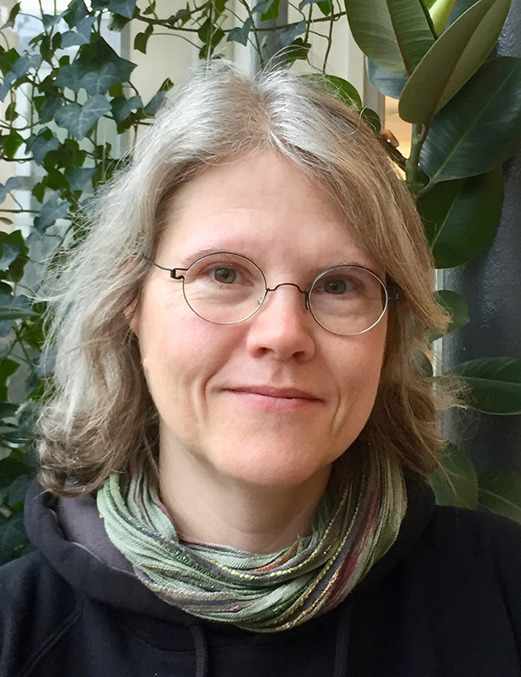
Short Introduction
GEDE is
a loose collaboration of 47+ research infrastructures
a platform to interact about specific topics of relevance
based on voluntary participation of experts/doers
is „neutral“ and „politics-free-zone“
is based on „rough consensus“
is run by co-chairs (Carlo, Peter) + Edit/Suzi
PS: many thanks to Maggie and her excellent contributions
GEDE is now asked officially to contribute to the EOSC process
via EOSC Sec Project supporting the EOSC boards
Questions
shall we accept that request?
co-chairs are positive but ...
if so what kind of tasks?
if so what kind of structure?

Slide 4
Welcome to Michel and Bert
Michel Schouppe
Senior expert - European Open Science Cloud, EC,
DG Research and Innovation, Open Science Unit RTD.G4
Involved in cross-cutting European policy files related to big data management
and open data sharing
Bert Meerman
director of the GO FAIR Foundation (GFF), legal entity associated to the
GO FAIR Int’l Support & Coordination Office. (GFISCO).
GFF plays a role in 2 EOSC projects :
The setup of the EOSC Secretariat, with the role to support the Executive Board of the EOSC. Member of the EOSC Secretariat Steering Group
Participation in the NORDIC FAIR project to provide expertise for evaluation the FAIRness of metadata and datasets.
Discussion & Questions

Slide 5
GEDE Constraints
GEDE needs to remain a neutral group driven by the interests of its members & needs to be free in its actions organised by its co-chairs and regular member meetings.
GEDE as contributor to the EOSC process needs to be driven by one "topic group" within GEDE that needs to carry out the specified work and report on it given specific deadlines etc.
This work can only be accepted if there is a funded core team (3-4) that take care.
All administrational details for GEDE will be handled by V&V (Vision & Values is a Brussel company directed by Edit Herzcog, already now supporting the GEDE work administrationally)

Slide 6
Possible GEDE Tasks
analysing the actual work dimensions of the ESFRIs and research infrastructures
identifying so called common infrastructure components and abstracting from their individual flavours
describe their characteristics and interfaces using also knowledge from RDA groups, stimulating new RDA groups, etc.
relate the outcome of specifications of reference architectures with work done within RIs etc.
continue the intensive work on FAIR Digital Objects continue the work by addressing specific topics of interest
organising surveys related to EOSC based on questionnaires & analysing the outcome of these surveys
(current questionnaire & doc is an example)
organising webinars and workshops on topics related to EOSC

Slide 7
Decision & Procedure
Does GEDE accept the request and contribute to EOSC process along the lines being discussed?
(Do the GEDE delegates support the co-chairs‘ vote here?)
Do we agree to define a „special topic“ driven by small core group that take care (specifications, plans, deadlines etc.)?
Are their volunteers for such a group? Do they have time?
All decisions and the request for volunteers will be sent to the whole group to see for comments (1 week slot!).

Slide 8
GEDE Activities
GEDE has currently the following activities
the document on views on EOSC
(to be structured, commented as Google Doc, 1 version in 3 weeks, team)
participating in a broad analysis on technologies used
(activity together with GOFAIR, ENVRI-FAIR, early analysis in RDA, launch
at Helsinki side meeting, currently tests with the questionnaire, could
run as an EOSC related topic since analysis will be hard)
topics active
(FAIR) Digital Objects (about 150 experts)
Blockchain (5 experts)
Repositories (10 experts)
Citation Harmonisation (12 experts)
new ideas?
certainly more interactions on EAOSC related matters

